Slide 1


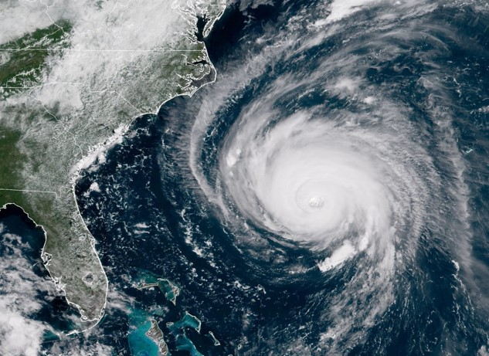
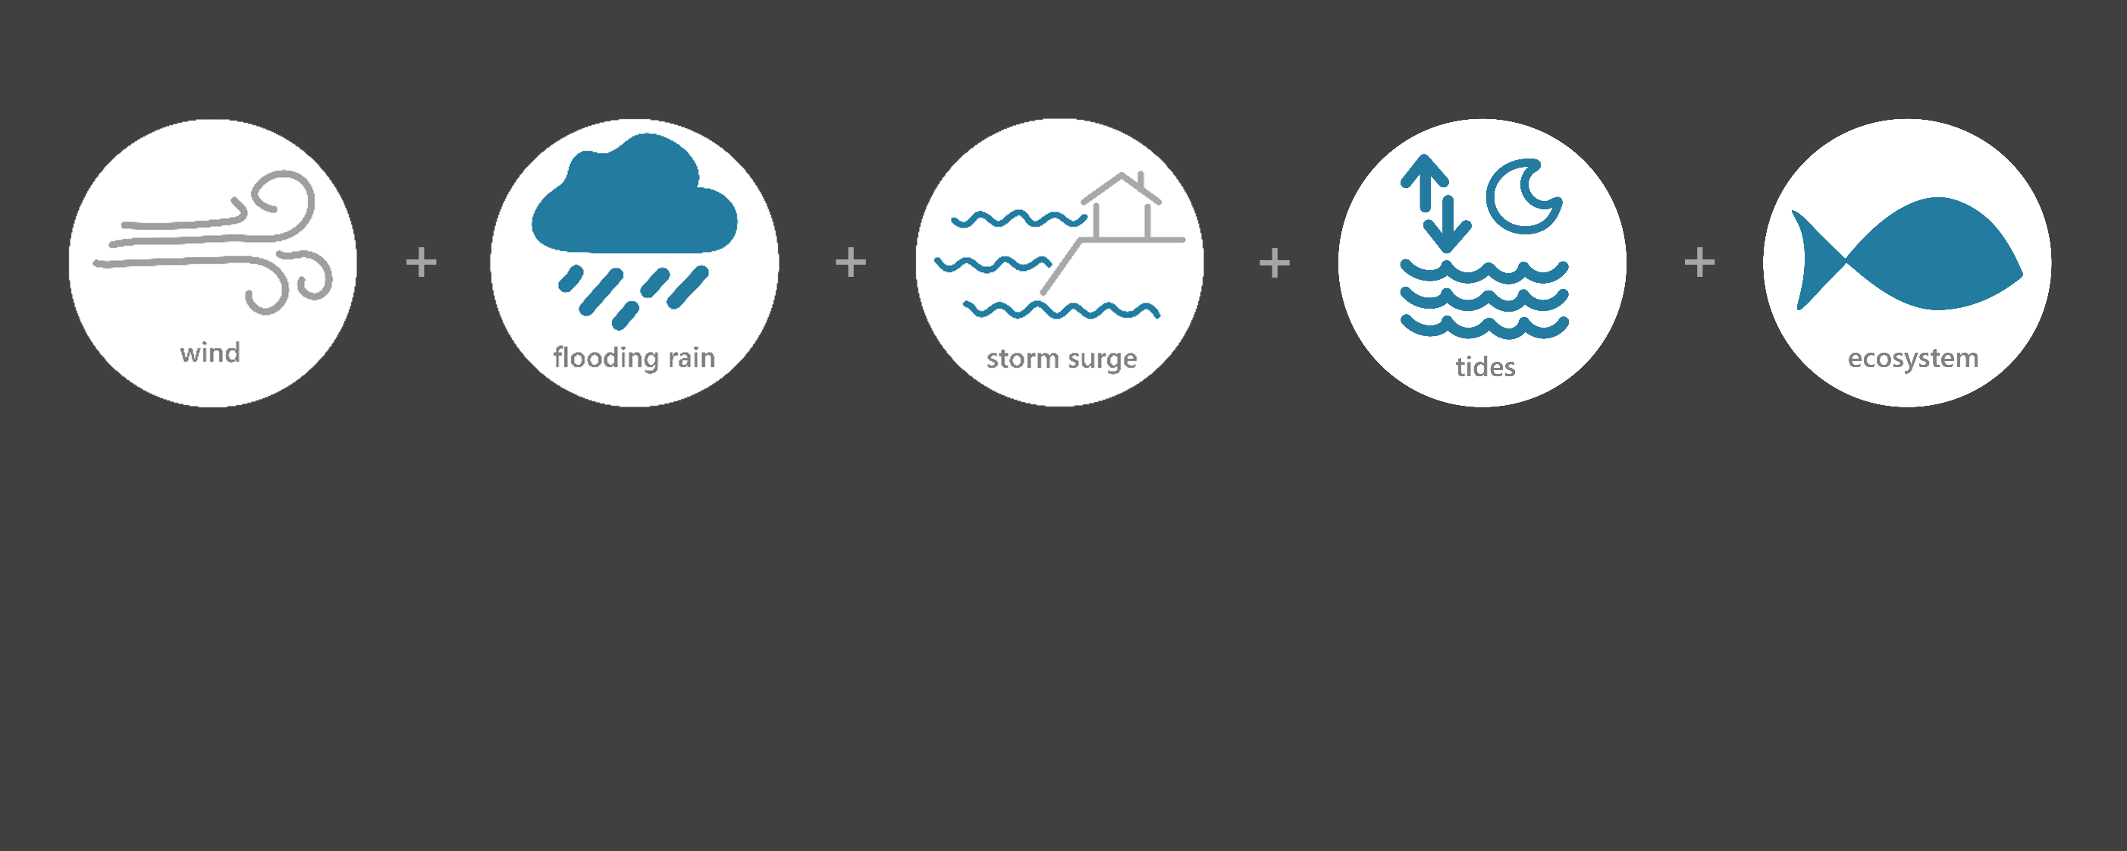

[ SEP 14 – SEP 18, 2018 ]
HURRICANE FLORENCE
TS
Category
(tropical storm)
10.5
Inches of Rain
44
Miles per hour
of Max Wind Speed
2.48
Feet of Storm Surge
(max)*
Image Credit: NOAA, taken on September 12, 2018
Monitoring the Impact of Hurricane Florence at “North Inlet – Winyah Bay”
Hurricane Florence, a large and slow-moving Category 1 hurricane, made landfall along the southeastern coast of North Carolina. As Florence traveled inland across South Carolina, it weakened to a Tropical Storm. Torrential rain fell for days and caused historic flooding. The most devastating impacts were not from the initial wind, rain, and storm surge but from the extreme riverine flooding that lasted for several weeks following Florence’s landfall. The effects of Florence were observed at the North Inlet –Winyah Bay (NIWB) Research Reserve through the System-Wide Monitoring Program (SWMP), which tracks short-term variability and long-term change of weather and water quality in the areas surrounding Georgetown, South Carolina.
Data shown are based on the NIWB weather monitoring site
*NOS Oyster Landing site
Created on April 22, 2022

Slide 2

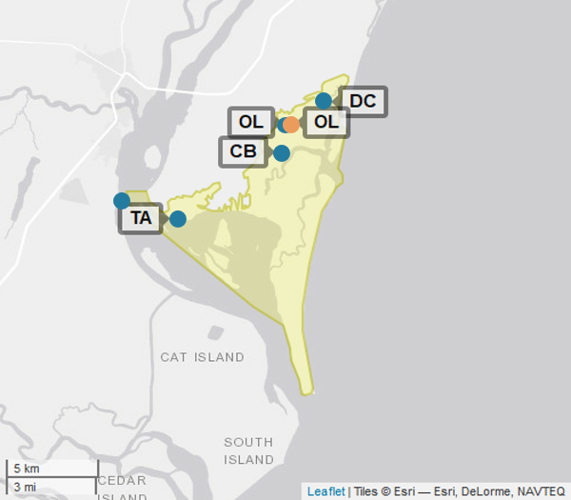
NIWB
North Inlet –Winyah Bay (NIWB) is one of 29 sites in the National Estuarine Research Reserve Systems (NERRS). Each site is a state-federal partnership that combines research, monitoring, and education to advance the understanding and management of estuarine environments.
NIWB
NERRS
Centralized Data
Management Office
NIWB Storm Monitoring
NIWB operates a weather station located in Oyster Landing (OL) and maintains six continuous, long-term water quality stations at Oyster Creek (OC), Debidue Creek (DC), Clambank (CB), Thousand Acre (TA), Winyah Bay Bottom (WB), and Winyah Bay Surface (WS) locations. NIWB is part of the SWMP. As Hurricane Florence approached South Carolina, NIWB monitored the weather and water quality, collecting data every 15 minutes for the following parameters: air temperature, relative humidity, atmospheric pressure, rainfall, wind speed and direction, water temperature, depth, salinity, dissolved oxygen, turbidity, and pH.
Weather Station
Water Quality Sample Location

Slide 3
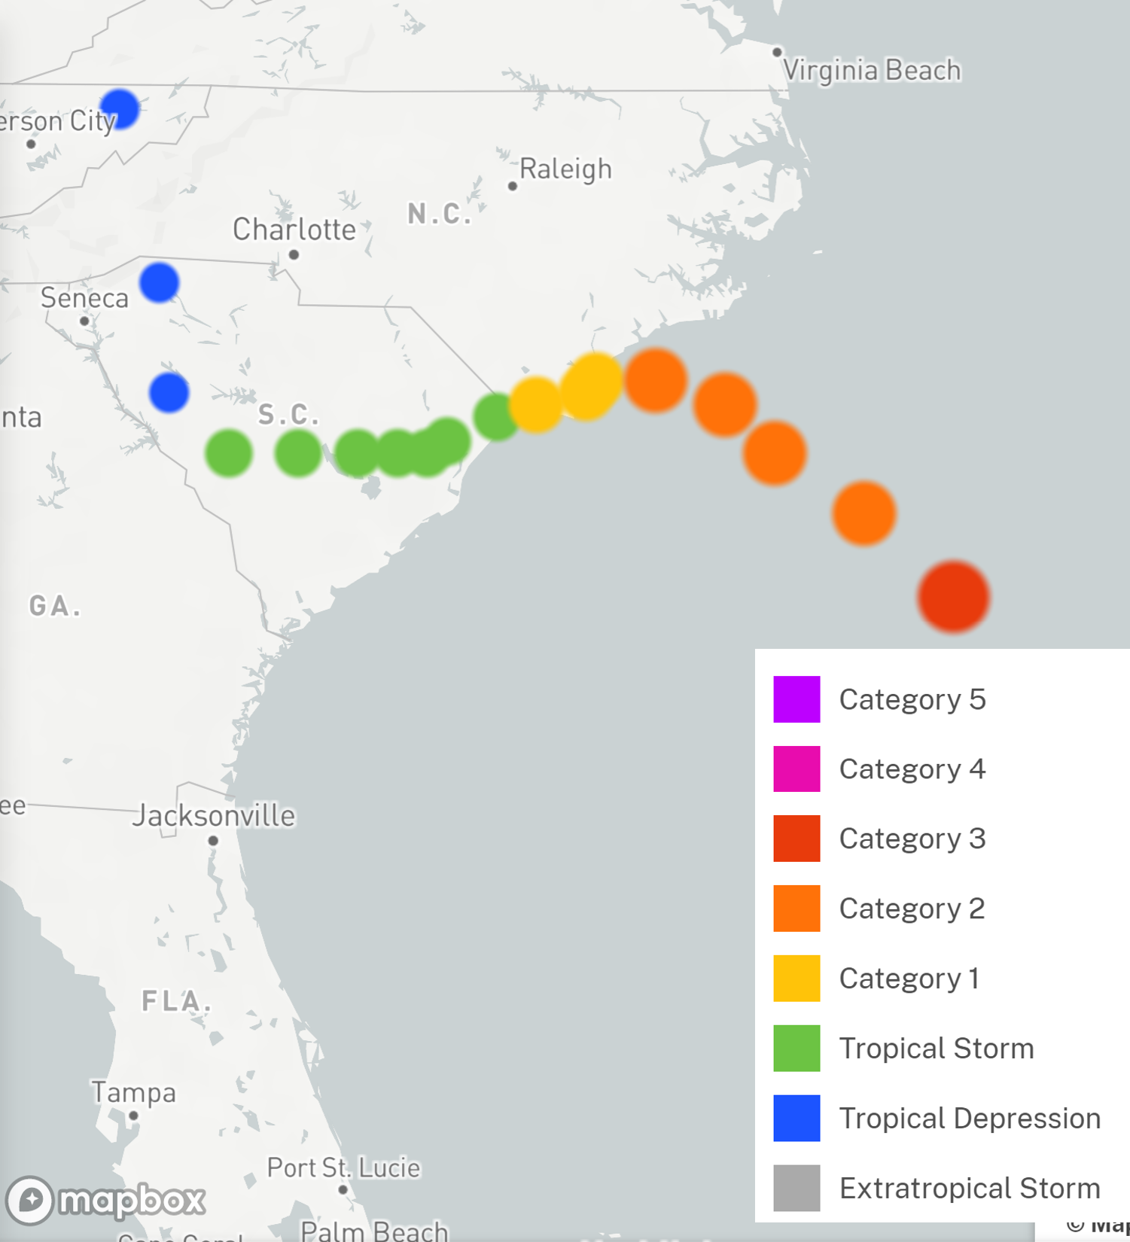
Florence made landfall near Wrightsville Beach, North Carolina on September 14. Florence stalled for an entire day before it began a slow turn to the southwest, traveling across South Carolina at a speed of 2-3 mph. The storm continued to weaken during September 15 and then traveled north-northeast out of the state on September 16.
In South Carolina, four direct fatalities resulted from freshwater flooding and were all vehicle related. SCEMD reported 11,386 homes with moderate or major damage across the state, 455,000 people evacuated, and 11 dams breached or failed. Flooding resulted in a lack of access to and from communities, complicating recovery and response efforts.
Source: https://oceanservice.noaa.gov/news/historical-hurricanes/
NIWB
Damage and losses due to Florence’s impacts in South Carolina totaled $2 billion.
Florence was a Category 1 on the Saffir–Simpson scale when it made landfall along the southeastern coast of North Carolina. By the time it reached the NIWB reserve, it was a Tropical Storm.
Aquatic life, like oysters, crabs, shrimp, finfish, phytoplankton, etc. rely on specific levels of salinity and dissolved oxygen to thrive and survive. The freshwater flooding that resulted from Florence caused significant drops in the levels of salinity and dissolved oxygen for varying periods of time, potentially stressing organisms.
Station | Date | Rainfall Total (in) | Rainfall Average Intensity (in/hr) | Wind Speed Max (mph) | Wind Speed Average (mph)
Oyster Landing | 9/14/2018 | 2.31 | 0.121 | 41.2 | 29.9
Oyster Landing | 9/15/2018 | 3.46 | 0.144 | 44.5 | 30.4
Oyster Landing | 9/16/2018 | 3.58 | 0.149 | 36.0 | 24.2
Oyster Landing | 9/17/2018 | 0.83 | 0.034 | 31.1 | 17.3
Oyster Landing | 9/18/2018 | 0.31 | 0.013 | 17.4 | 12.0
The highest local rainfall and wind measurements were recorded when Florence made landfall in North Carolina and then moved and traveled across South Carolina.
Data reporting time periods for Hurricane Florence: 9/14/2018 - 9/18/2018

Slide 4
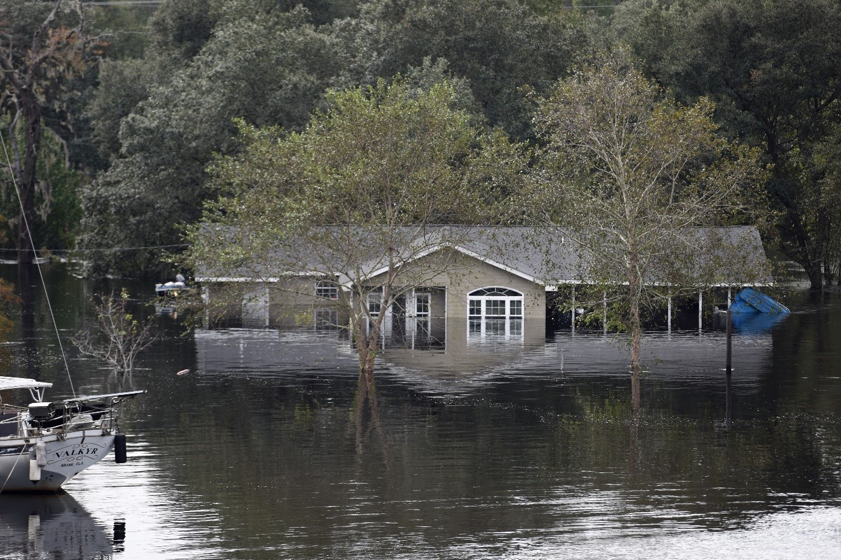
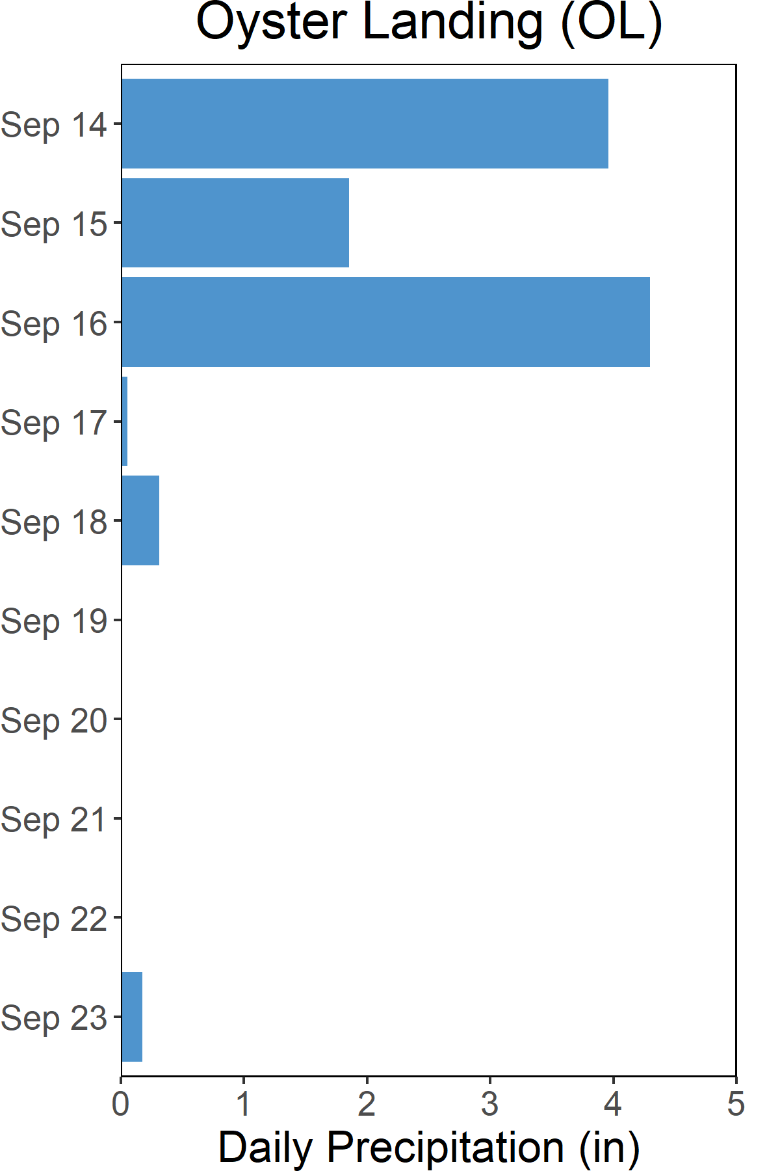
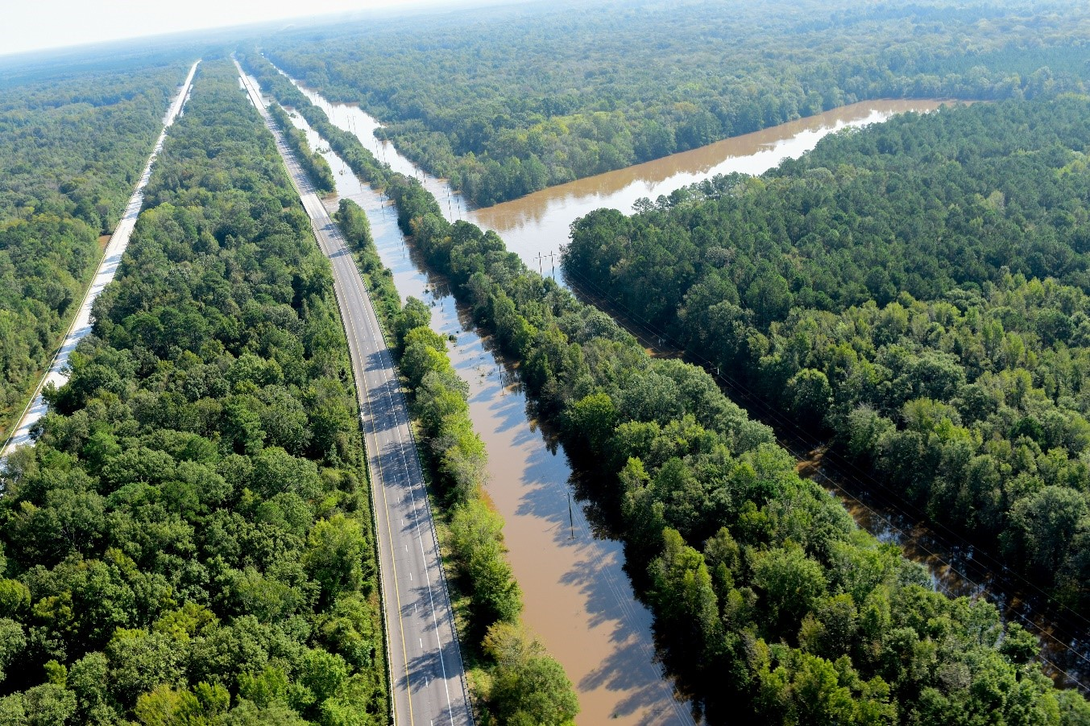

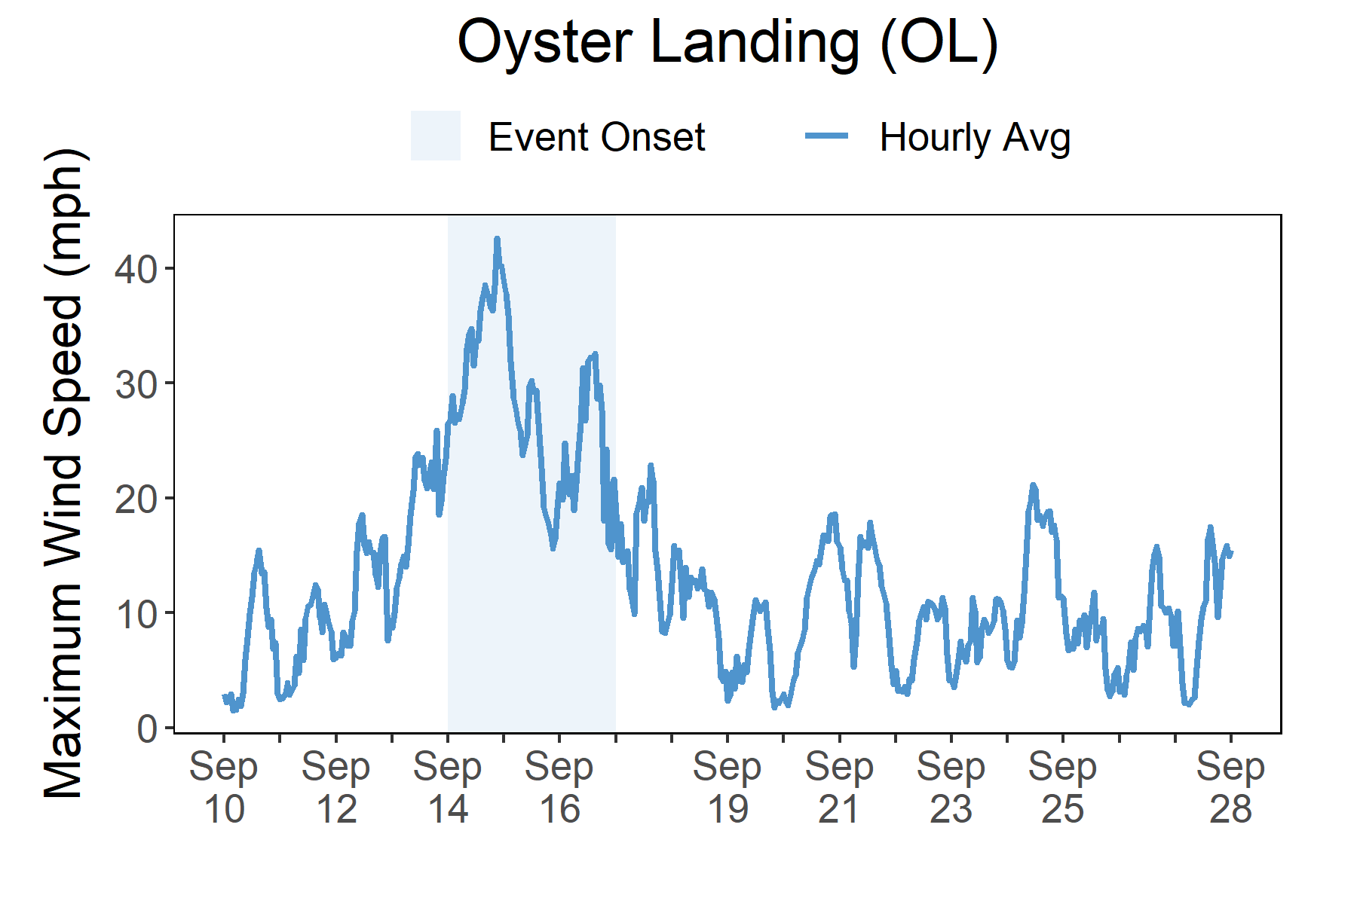

Rainfall
Florence brought heavy rains and freshwater flooding to South Carolina.
A total of 10.5 inches of rainfall fell in the reserve area over the course of five days as a result of the slow-moving and heavy rain-producing Hurricane Florence. A combination of heavy local rain and floodwaters coming down from North Carolina resulted in extensive flooding in Yadkin-Pee Dee River Basin.
Photos from the SC National Guard, taken in Conway, SC (Horry County) on September 25, 2018.
Initial impacts from Hurricane Florence were felt locally from the heavy rains and high winds, including flooding, downed trees, power outages, and some damage to building structures. However, the most devastating impacts happened several weeks later. While landfall occurred in North Carolina, the storm's slow forward movement and unique track brought unprecedented rainfall across large portions of North and South Carolina, resulting in several weeks of extreme riverine flooding. All of the rain that fell in North Carolina (up to 3 feet in some locations) had to travel downstream and flow straight through major rivers in South Carolina to reach the Atlantic Ocean through Winyah Bay. On Sept. 25, in Georgetown County, authorities urged thousands of people to evacuate ahead of the historic flooding. Making matters worse was the potential for tides to exacerbate floodwater levels. Flood waves on the Waccamaw and Great Pee Dee rivers reached the city of Georgetown (~2 weeks post landfall), causing flooding across several tide cycles. The extensive flooding required coordination and support from the Federal Emergency Management Agency (FEMA), the American Red Cross and aid from state and local agencies.
Rainfall measurements at the Oyster Landing weather station from Sept. 14 through Sept. 23.
Wind Speed
Max wind speed recorded at the reserve was 44 mph on Sept. 14.
Maximum Wind Speed readings at the Oyster Landing weather station from Sept. 7 through Sept. 28.

Slide 5
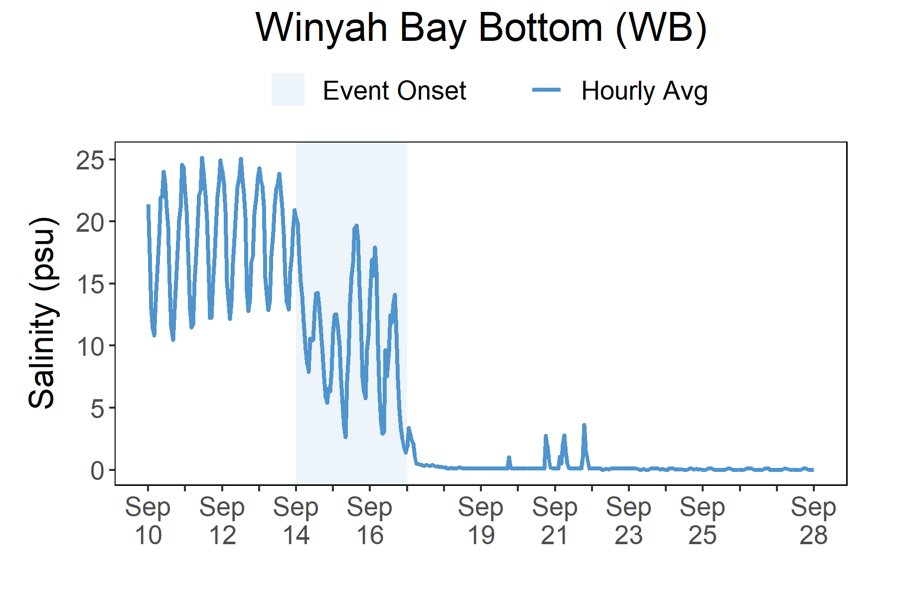
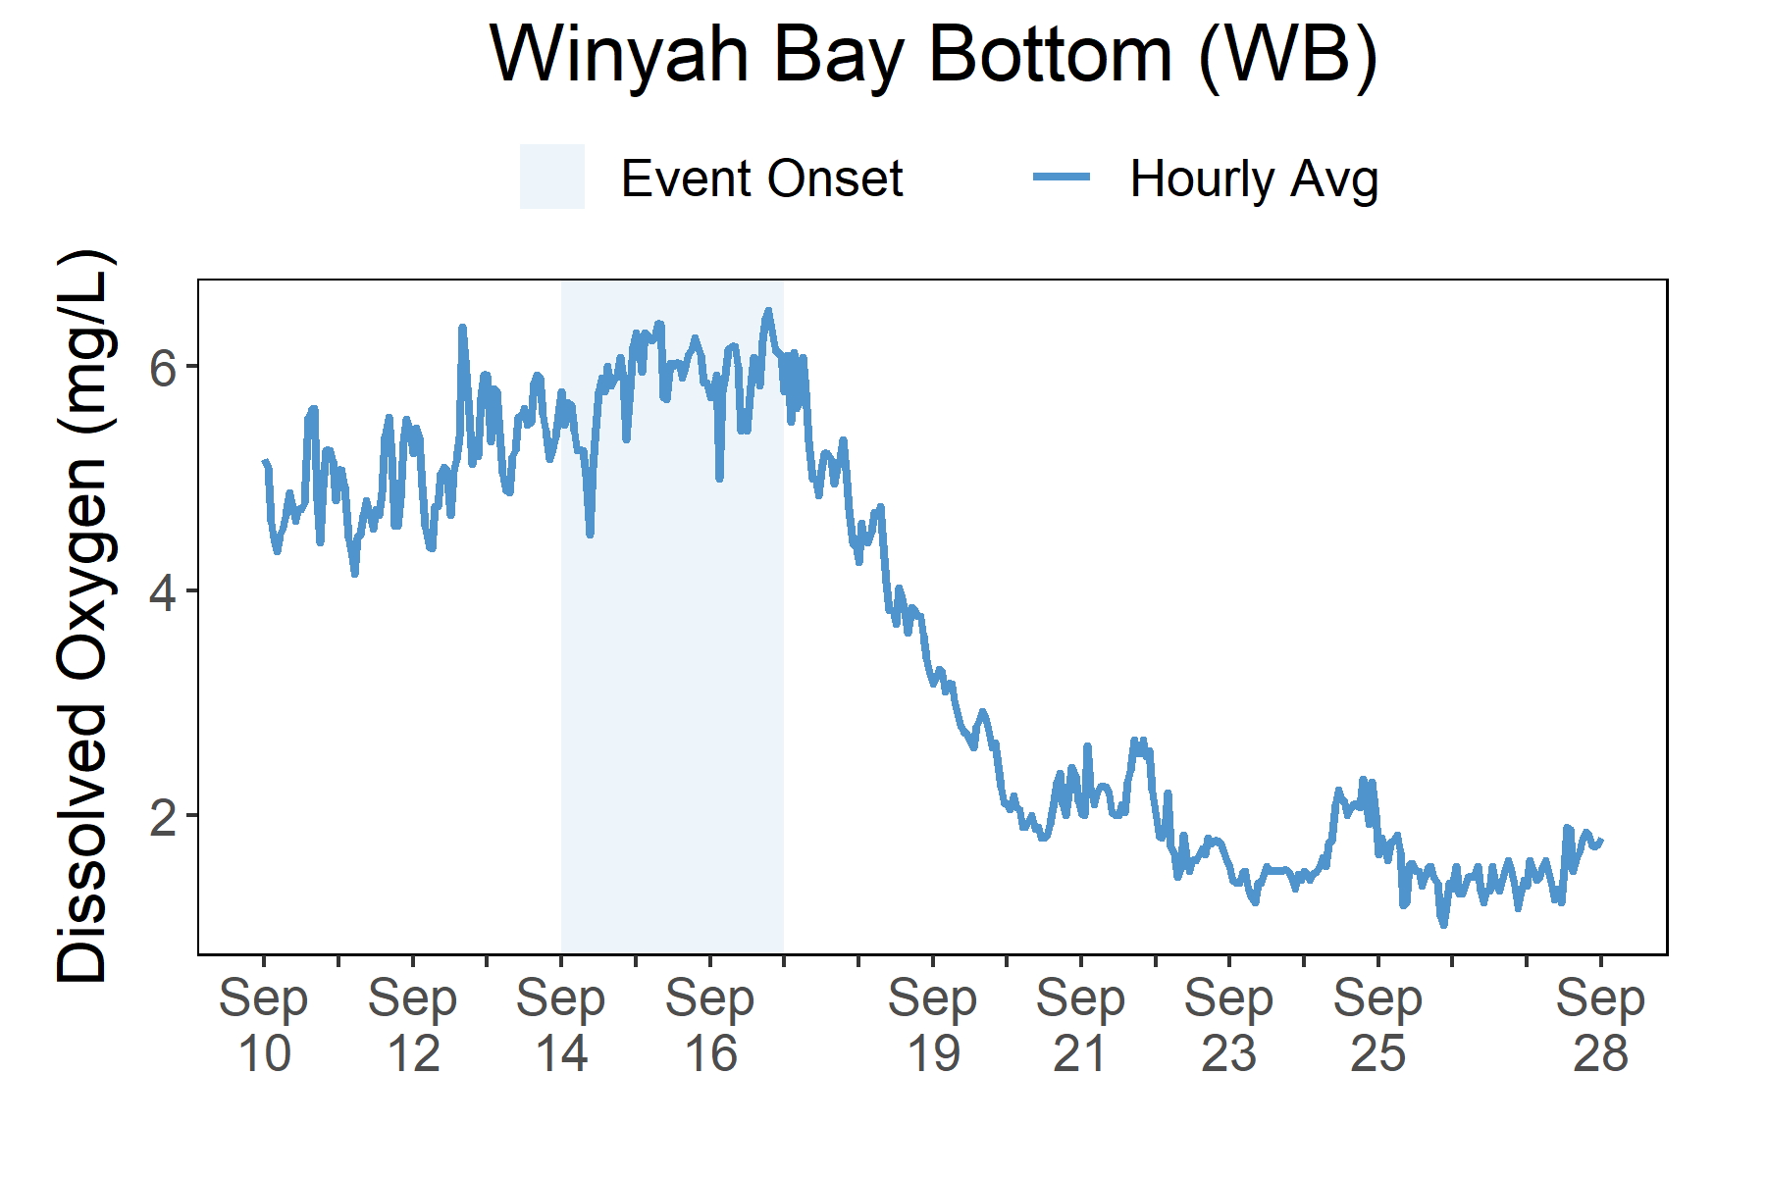
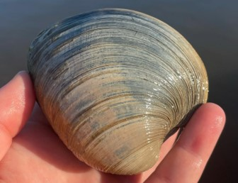
Salinity levels quickly dropped at Thousand Acre (TA) as Florence approached the reserve and then remained low as extreme freshwater flooding came to the area over a week later.
Station | Date | Depth Maximum (ft) | Salinity Minimum (psu) | Salinity Maximum (psu) | Dissolved Oxygen Minimum (mg/L) | Dissolved Oxygen Maximum (mg/L)
Winyah Bay Bottom | 9/14/2018 | 18.14 | 6.8 | 21.6 | 4.5 | 6.1
Winyah Bay Bottom | 9/15/2018 | 18.73 | 2.5 | 20.4 | 5.0 | 6.5
Winyah Bay Bottom | 9/16/2018 | - | 2.3 | 19.3 | 3.7 | 6.7
Winyah Bay Bottom | 9/17/2018 | - | 0.3 | 5.7 | 4.7 | 6.5
Winyah Bay Bottom | 9/18/2018 | 17.78 | 0.1 | 0.3 | 3.1 | 5.4
Data reporting time periods for Hurricane Florence: 9/14/2018 - 9/18/2018
Salinity
Dissolved Oxygen
A big and fast drop in salinity occurred as flooding followed for weeks after Florence
Post-Storm Levels ~1 - <3 mg/L
A drop in dissolved oxygen
followed with the flooding
Pre-Storm Levels ~4-7 mg/L
Pre-Storm
Levels ~11->20 psu
Post-Storm
Levels ~0-3 psu
Salinity levels from Sept. 7 to Sept. 28.
Dissolved Oxygen levels from Sept. 7 to Sept. 28.
Salinity and Dissolved Oxygen levels that were recorded at the Winyah Bay (WB) station show initial and post-storm impacts on water quality in this area. Salinity levels quickly dropped at the onset of the storm, recovered slightly as the storm moved on, and then dropped significantly for an extended period of time as the area experienced extreme flooding. Dissolved oxygen levels were impacted as well but the impact was more prominent post-storm when the flooding was most severe. The regular diurnal cycle was compressed and levels stayed in a lower range (< 3 mg/L) during the flooding. Dramatic changes in salinity and lower levels of oxygen can cause stress to some aquatic organisms depending on the species and how long the levels deviate from what is normal. Water quality stresses can impact survival and future populations.

Slide 6
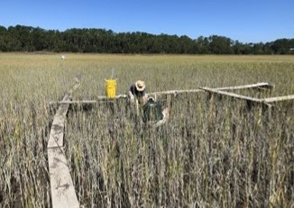
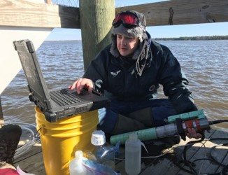
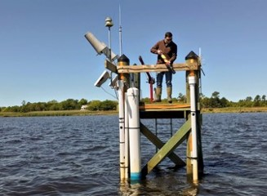
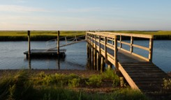
Maeve Snyder, Coastal Training Program Coordinator e: msnyder@baruch.sc.edu p: 843.904.9034
Visit www.nerrsdata.org to view and download weather and water quality data from North Inlet - Winyah Bay NERR.
Interested in learning more? Visit http://northinlet.sc.edu/. For video, news updates, online storm data and prediction visualization tools, check out our Storm Story Map at www.storm storymap.url.
@NIWBReserve

